Slide 1

A HYBRID APPROACH FOR CROP YIELD PREDICTION USING A GRADIENT-ENHANCED MULTIPLE LINEAR-POLYNOMIAL MODEL
1

Slide 2
INDEX
Abstract
Introduction
Literature Survey
Research Gaps Identified
Proposed Work
System Architecture
Algorithm
Dataset Used
Results and Discussion
Conclusion
References
2

Slide 3
ABSTRACT
Accurate crop yield prediction is essential for optimal agricultural resource management and food security. Traditional models, limited by few environmental parameters, often yield suboptimal results. This study proposes a Hybrid Gradient-Enhanced Multiple Linear-Polynomial (GEMLP) model, combining Multiple Linear Regression (MLR), Polynomial Regression (PR), and Gradient Boosting Regressor (GBR) for improved accuracy. The model incorporates ensemble learning, polynomial feature expansion, and hyperparameter tuning, leveraging key variables such as temperature, rainfall, and pesticide use. Experimental results show a substantial reduction in Mean Squared Error (MSE) and a significant increase in R² score (97%), outperforming conventional methods. GEMLP model offers a scalable, robust, and data-driven framework for precision agriculture, enabling informed decision-making, resource optimization, and promoting sustainable farming practices.
3

Slide 4
INTRODUCTION
Conventional farming often depends on intuition, leading to low accuracy in yield forecasting, inefficient resource use, and reduced profitability due to overuse of water, pesticides, and fertilizers
GEMLP model evaluates factors like soil health, temperature, rainfall, and pesticide use to forecast yields, helping farmers select suitable crops and plan resources efficiently, ultimately increasing productivity while minimizing waste.
By reducing over-reliance on chemicals and water, the model helps maintain soil integrity, supports eco-friendly practices, and aligns with green agriculture goals.
The hybrid model uses historical and real-time environmental data to provide resilient strategies for coping with unpredictable weather, enabling better planning and crop management
GEMLP model empowers farmers with data-driven decisions, leading to lower input costs, higher yields, and better alignment with market trends, ensuring both sustainability and profitability
4

Slide 5
LITERATURE SURVEY
S.NO | Author & Year | Technology Used | Advantages | Limitations
1. | Kuradusenge et al. (2023) | Random Forest (RF), Polynomial Regression (PR), Support Vector Regressor (SVR) | RF achieved high accuracy; identified optimal weather for potatoes and maize | Limited to Musanze district; only used rainfall and temperature
2. | Musanase et al. (2023) | Machine Learning, IoT, Data-driven Analysis | Enabled real-time insights; improved precision farming and productivity | Requires robust IoT infrastructure; high data processing needs
5

Slide 6
3. | Ali et al. (2022) | Remote Sensing (RS), Hyperspectral & Multispectral Imaging, Radar, Lidar, Spectroscopy | Effective for large- scale monitoring and early disease detection | High-resolution imagery is expensive; demands significant computational resources
4. | Abbas et al. (2020) | Linear Regression (LR), Elastic Net, k-NN, SVR | SVR performed well; use of proximal sensing improved accuracy | Ineffective k-NN; required large datasets for reliable results
5. | Tian et al. (2020) | Hybrid MLR-ANN, SVR, Random Forest | Increased accuracy with reduced computation time | Focused only on paddy; validated on limited datasets
6

Slide 7
RESEARCH GAPS IDENTIFIED
Many models use only basic parameters like rainfall and temperature, ignoring critical factors such as pesticides, soil type, and real-time weather variations.
Most studies are constrained to specific regions, reducing their generalizability to diverse agro-climatic zones.
Few works combine linear, non-linear, and ensemble learning methods in a unified framework for yield prediction.
Existing models often struggle to scale with larger datasets or adapt to multi-crop prediction scenarios.
7

Slide 8
PROPOSED WORK
Goal: Develop an accurate, scalable crop yield prediction model using a hybrid GEMLP approach
Model Components:
MLR for linear trends
PR for non-linear relationships
GBR for boosting prediction accuracy
Inputs Used: Rainfall, temperature, pesticide use, and historical yield data
Techniques Applied:
Feature engineering (encoding, standardization, polynomial expansion)
Ensemble learning with performance tuning
Evaluation using MSE, RMSE, MAE, R²
Outcome: Achieves high accuracy (R² ≈ 97%), supports precision agriculture, and enables resource-efficient planning
8

Slide 9
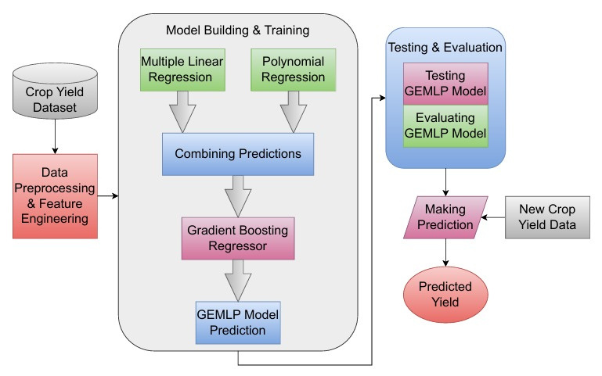
SYSTEM ARCHITECTURE
Fig.1: Gradient-Enhanced Multiple Linear-Polynomial (GEMLP) Model

Slide 10
ALGORITHM
Algorithm: Gradient-Enhanced Multiple Linear-Polynomial(GEMLP) Model
Input:
Dataset (X,Y): Features (rainfall, pesticides, temperature) & target (crop yield)
Hyper parameters: Learning rate (), polynomial degree (d=2), GBR parameter
Models Used:
Multiple Linear Regression (MLR)
Polynomial Regression (PR)
Gradient Boosting Regressor (GBR)
10

Slide 11
Output:
Trained GEMLP Model
Performance Metrics (MSE, RMSE, MAE, , Adjusted
Predicted crop yield
Step-by-Step Algorithm:
Data Preprocessing
Load and clean the dataset (handle missing values, feature selection)
Convert categorical features (One-Hot Encoding)
Scale numerical features using MinMaxScaler
Split data into Training (80%) & Testing (20%) sets
Model Training
Train Multiple Linear Regression Model (MLR):
Compute output:
11

Slide 12
Train Polynomial regression (PR) (degree=2)
Transform input:
Compute outputs:
Combine outputs: +
Train Gradient Boosting Regressor(GBR) on combined features(Z,Y)
Model Evaluation (Testing phase)
Predict crop yield on test data
Compute performance metrics
MSE, RMSE, MAE, , Adjusted
Convert kg/ha to hg/ha for yield metrics
Results & Deployment:
Visualize results (bar charts, correlation heatmap, scatter plots)
Save trained model for futher predictions
12

Slide 13
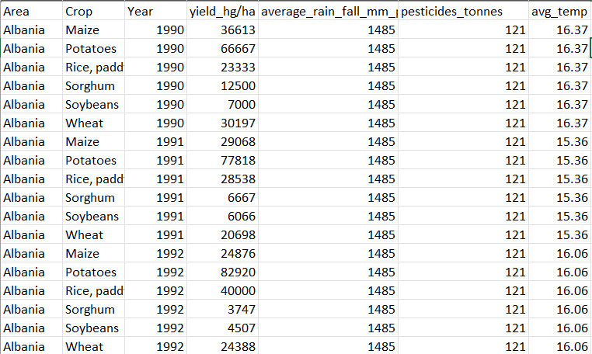
DATASET USED
Fig.2:Dataset
13

Slide 14
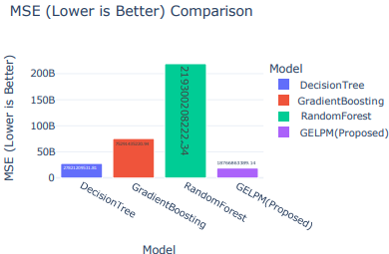
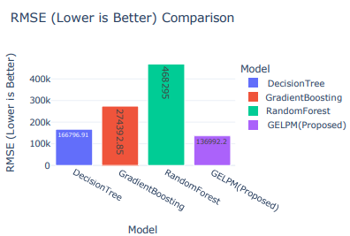
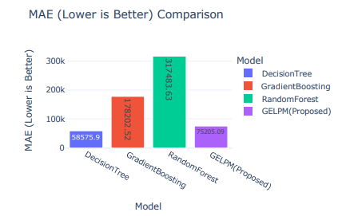
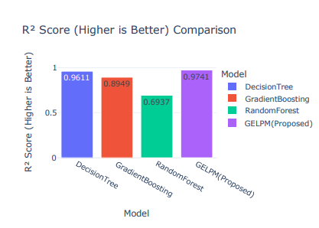
RESULTS AND DISCUSSION
Fig.3: MSE
Fig.4: RMSE
Fig.5:MAE
Fig.6: R² Score
14

Slide 15
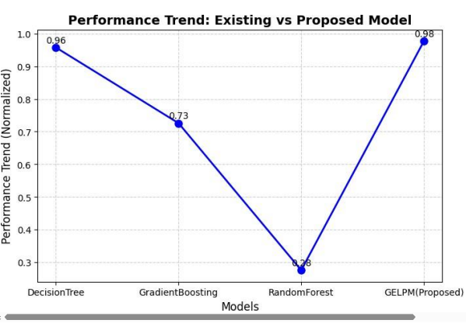
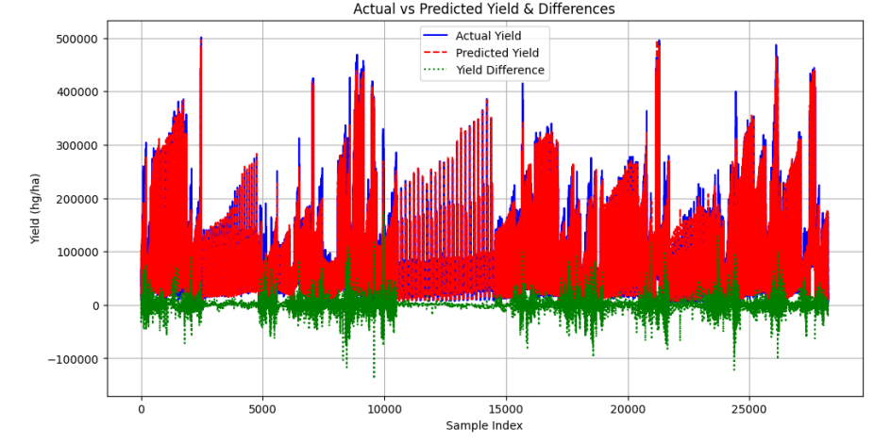
Fig.7: Existing vs Proposed Model
Fig.8: Actual Yield vs Predicted Yield & Yield Differences
15

Slide 16
CONCLUSION
The GEMLP Model significantly improves crop yield estimation using linear regression, polynomial transformation, and ensemble learning techniques to make better predictions.
The model employs various agronomic parameters for optimal resource utilization and sustainable agricultural development.
GEMLP Model information enables farmers, policymakers, and stakeholders to make better, data-based decisions that can enhance agricultural planning.
The model is scalable and extendable to other crops and geographic locations, making it increasingly applicable across the world.
The future work can extend the model further by including IoT-based real-time monitoring and remote sensing data, further increasing predictive capability for precision agriculture.
16

Slide 17
REFERENCES
Kuradusenge, Martin, et al. "Crop yield prediction using machine learning models: Case of Irish potato and maize." Agriculture 13.1 (2023): 225.
Musanase, Christine, et al. "Data-driven analysis and machine learning-based crop and fertilizer recommendation system for revolutionizing farming practices." Agriculture 13.11 (2023): 2141.
Ali, Abdelraouf M., et al. "Crop yield prediction using multi sensors remote sensing." The Egyptian Journal of Remote Sensing and Space Science 25.3 (2022): 711-716.
Abbas, Farhat, et al. "Crop yield prediction through proximal sensing and machine learning algorithms." Agronomy 10.7 (2020): 1046.
Tian, Li, et al. "Yield prediction model of rice and wheat crops based on ecological distance algorithm." Environmental Technology & Innovation 20 (2020): 101132.
17

Slide 18
THANK YOU
18

